Slide 1

A Quantitative Analysis of Severity Grading of Knee Osteoarthritis
B.Sc. in Computer Science and Engineering Thesis
Bangladesh University of Engineering and Technology
Presented by
Asif Ihtemadul Haque
1805048
Shamim Al Mamun
1805060
Supervised by
Dr. Mahmuda Naznin
Professor, Dept. of CSE, BUET

Slide 2
Overview
Problem Definition
Motivation
Challenges
Literature Review
Methodology
Results
Performance
Our Contribution
Future Direction

Slide 3
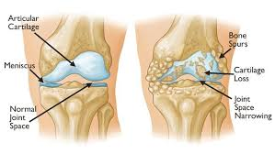
Problem Definition
Knee osteoarthritis (OA) is a degenerative joint disease that affects the cartilage and bones within the knee joint, leading to pain, stiffness, and decreased mobility.
One of the most common causes of disability in adults.​

Slide 4
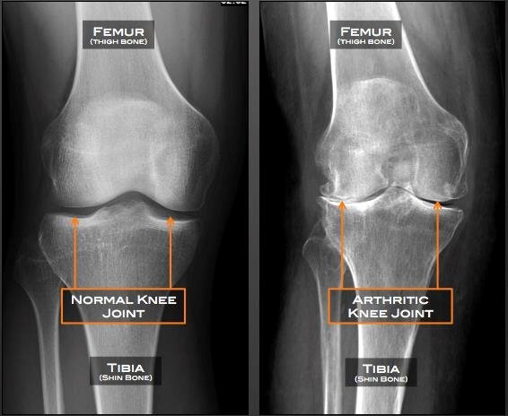
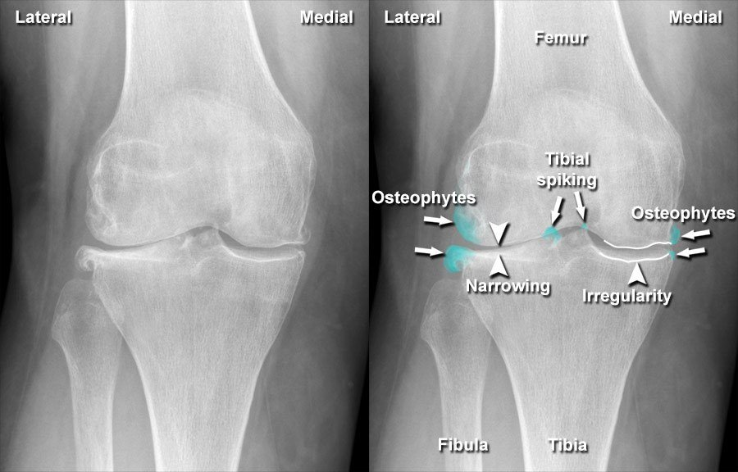
Problem Definition (Contd.)
Typically detected through X-rays​.
Most common symptom: Joint Space Narrowing​
Another common symptom: Presence of Osteophytes​

Slide 5
Motivation

Slide 6
Motivation
In 2020, estimated 654.1 million individuals (aged 40 years and older) were affected globally.​
Significantly impacts individuals' quality of life.​
Traditionally, Knee OA (KOA) has been assessed using qualitative methods such as the Kellgren-Lawrence (KL) grading system.​

Slide 7
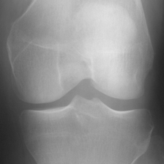
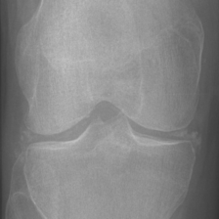
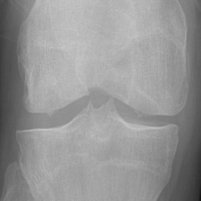
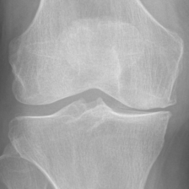
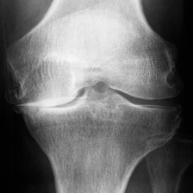
What is KL Grading System?​
Categorizes the current state of the disease, based on the Joint Space Narrowing, Osteophyte count etc.​
Grade 0: No OA features.
Grade 1: Doubtful narrowing, possible osteophytes. ​
Grade 2: Definite osteophytes, possible narrowing. ​
Grade 3: Multiple osteophytes, definite narrowing, possible deformity. ​
Grade 4: Large osteophytes, marked narrowing, severe sclerosis, definite deformity.​​

Slide 8
Limitations of KL Grading
Variability in Diagnosis : Different clinicians' interpretations can vary, leading to inconsistent KL grades and unreliable diagnoses.
Potential Inaccuracies : Subjective interpretation can lead to inaccurate grades.​
Inconsistent Treatment Plans ​: Diagnostic variability causes inconsistent treatment plans. ​
Lack of Precision : Lacks precision, offering broad categorization but not detailed assessment or progression monitoring.​

Slide 9
Challenges

Slide 10
Challenges
Lack of Labelled Data : Absence of ground truth labels complicates the validation of edge detection and gap measurement techniques.
Low-Quality X-ray Images : Low-resolution and poor-contrast X-ray images create difficulties in accurately processing anatomical structures.
Inaccurate Detection with FastSAM : Lacks precision for X-ray images due to its generic nature, smoothing out critical necessary details.
Reliance on Opinion-Based KL Grading : Subjective KL grading introduces variability and potential bias, affecting the reliability of decisions.

Slide 11
Literature Review

Slide 12
Literature Review
Kondal et al. [1]: Used a two-stage CNN model for KL grading; highly dependent on dataset quality and lacks generalizability.
Antony et al. [2]: Proposed FCN for knee joint localization and CNN for severity quantification; requires significant computational resources.
Brahim et al. [4]: Combined image pre-processing with machine learning for early OA detection; relied on manual feature engineering and showed inconsistent performance across datasets.

Slide 13
Problem Formulation

Slide 14
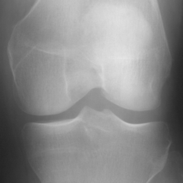
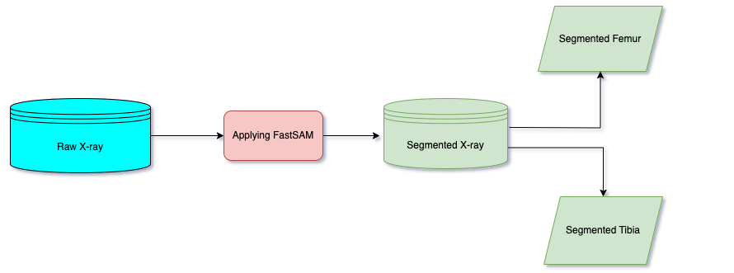
Dataset 1 : Original X-ray
Contains knee X-ray images labeled with the severity of osteoarthritis (KL grading).
Grade 0-2 : Each contains 1000 images.
Grade 3 : Contains 750 images.
Grade 4 : Contains 150 images.
Resolution : 224 x 224 pixels, grayscale.
Source: Knee Osteoarthritis KL graded dataset

Slide 15
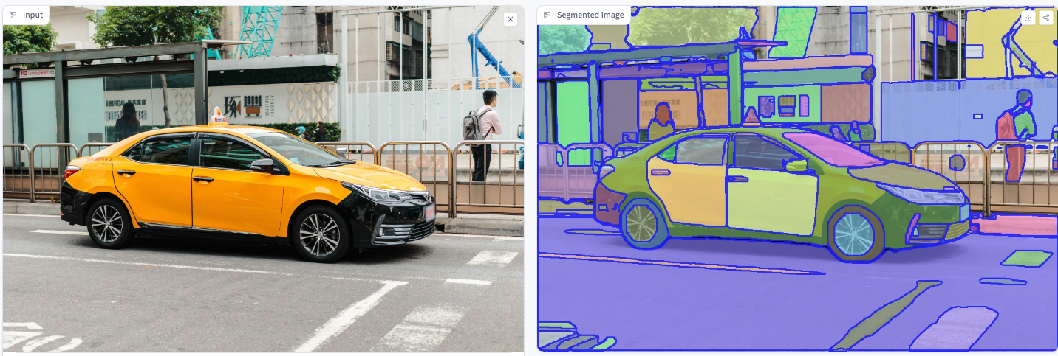
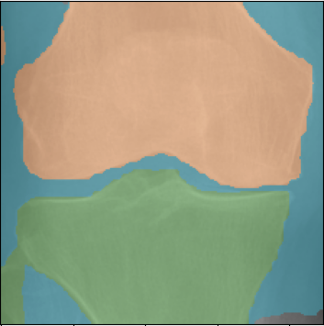
Dataset 2 : Fast Segmented Knee X-ray Images
FastSAM : CNN Segment Anything Model trained using only 2% of the SA-1B dataset.
Segmented X-rays are produced by applying FastSAM model on each original X-ray.
Source: Fast segmented Knee X-ray dataset
Applying FastSAM
Femur
Tibia

Slide 16
Methodology

Slide 17
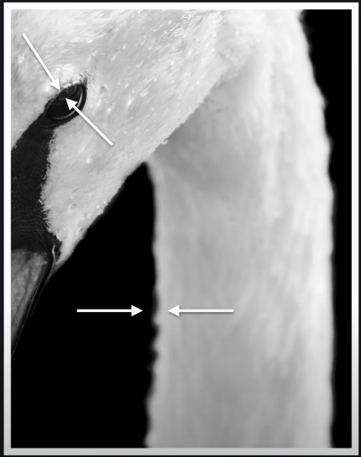
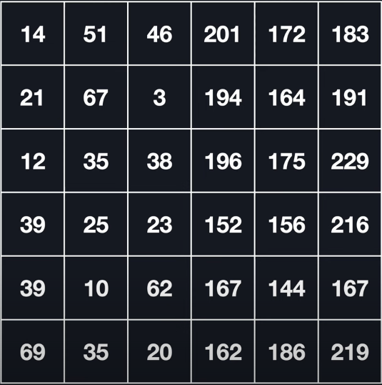
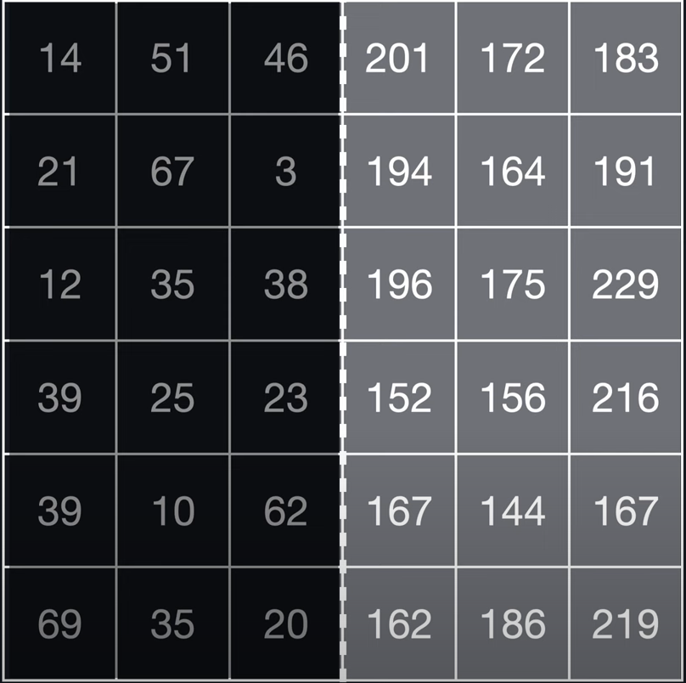
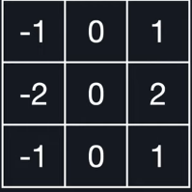
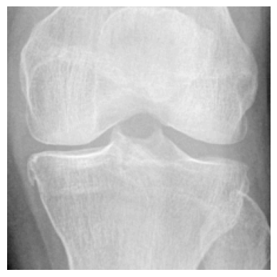
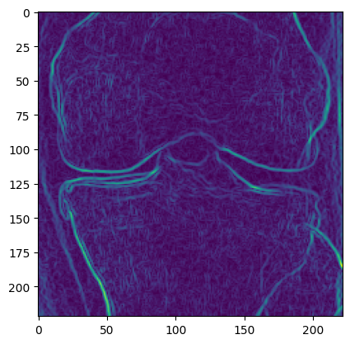
Initial Approach Using Sobel Operator
Sobel creates an intensity gradient which helps detect edges.
However, there is little isolating factor between the inside of a bone and the knee gap.
*
=
Inside of the bone
Applying Sobel
Knee gap

Slide 18
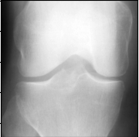
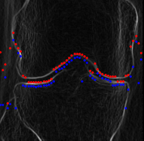
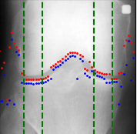
Findings from Sobel Operator
The colored dots cross over the knee gap and fail to detect edges on ROI.
Superimposed plotting on original X-ray image with ROI selected
Original X-Ray Image
Sobel Image with plotting

Slide 19
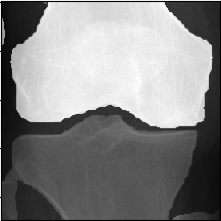
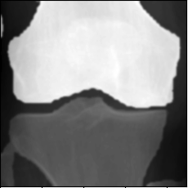
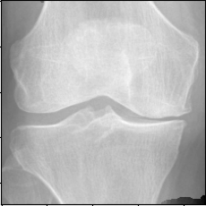

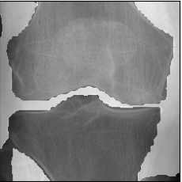
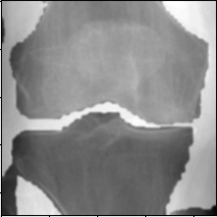
Applying Gaussian Blur on Segmented X-ray
Reduces noise
Kernel Size: 5 X 5
Red channel
Green channel
Blue channel

Slide 20
Adaptive Thresholding
Converts the blurred image into a binary image to highlight edges.
Adjusts the threshold value dynamically across the image to account for varying lighting conditions.
Pixels > Threshold 0 (black) Pixels < Threshold 255 (white).

Slide 21
Morphological Operations (Closing and Opening)
Closing:
Morphological closing is applied using a small kernel (3x3).
Closing helps to fill small holes or gaps in the binary image, connecting disjointed edges.
Performed twice to ensure better connectivity.
Opening:
Morphological opening is applied next to remove small noise and irrelevant details from the binary image.
Opening helps to clean up the image by removing isolated noise points.

Slide 22
Canny Edge Detection
Identifies and highlights the edges with pixel intensity changes.
Creates a clear outline of the structures in the image.
Add all 3 outputs of the channels so far through bitwise or.

Slide 23
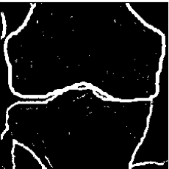
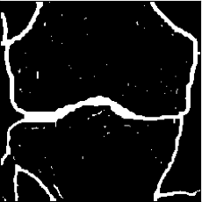
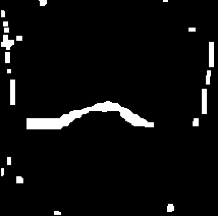
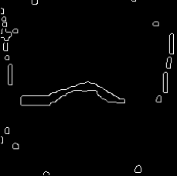
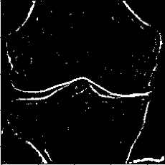
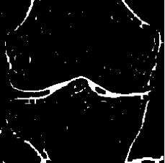
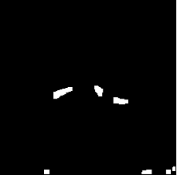
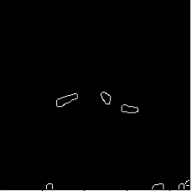
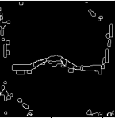
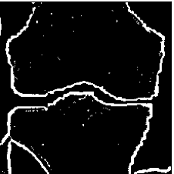
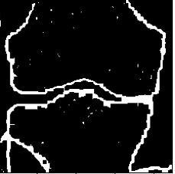
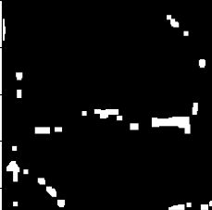
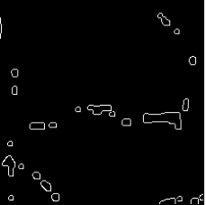
Processing Segmented X-ray
Gaussian Blur
Adaptive Thresholding
Morphological Closing
Morphological Opening
Canny
Combined edges
Red
Green
Blue

Slide 24
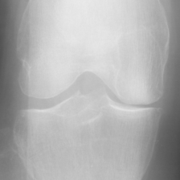
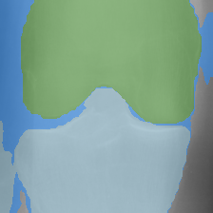
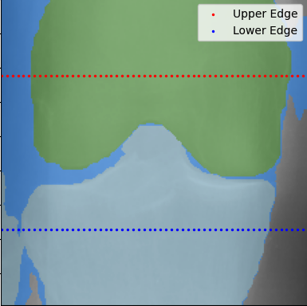
Initializing the Points
We try to find edges with the help of points or markers.
Red for upper edge, blue for lower edge.
Initial row index for starting the search for the upper edge (red), 1/4th from the top of the image.
Initial row index for starting the search for the lower edge (blue), 3/4th from the top of the image.
KL Grade 3 original X-ray
FastSAM X-ray
Points initialized

Slide 25
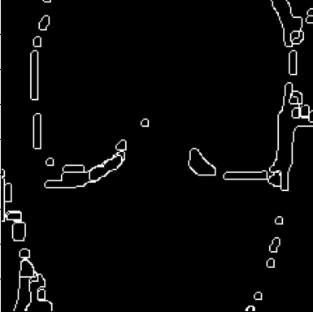
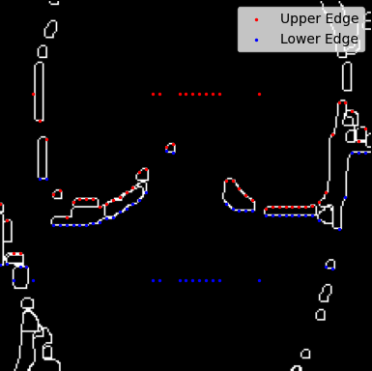
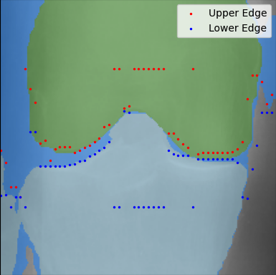
Aligning Points on Edges Using Preprocessed Image
For each column, searches from top to bottom within the specified range to find the upper edge.
Similarly, searches from bottom to top to find the lower edge.
Points on Preprocessed image
Points on FastSAM image
FastSAM X-ray
Preprocessed image

Slide 26
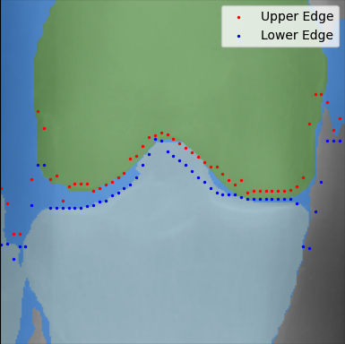
Applying Simulated Annealing
Only refine points that were untouched before.
Cost is based on the distance from the neighbouring points in the same row.
1000 iterations, 0.99 cooling rate.
Newer cost < current cost : improves the solution.
Newer cost > current cost: accepts but with a probability that decreases with temperature.
Before Simulated Annealing
After Simulated Annealing

Slide 27
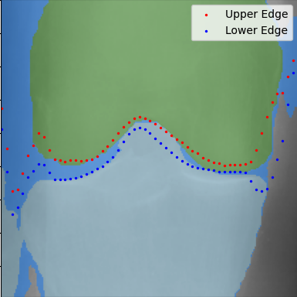
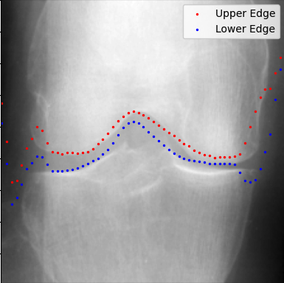
Applying Local Smoothing
1D convolution of window size=5.
Essentially slides the kernel over the input array of points and computes the weighted sum of the elements within the window.
Produces a smoothed output.
Before Local Smoothing
After Local Smoothing
Superimposing the points on original x-ray

Slide 28
Results

Slide 29
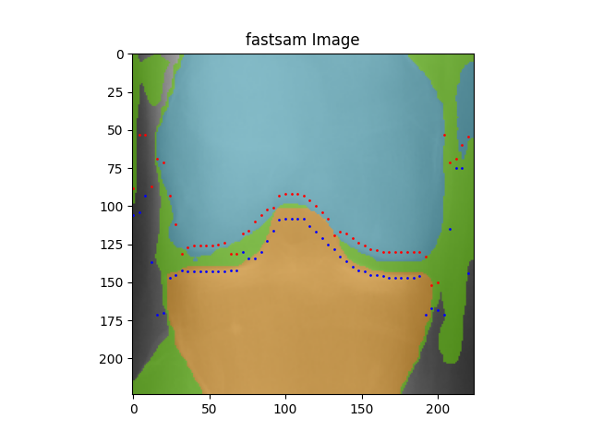
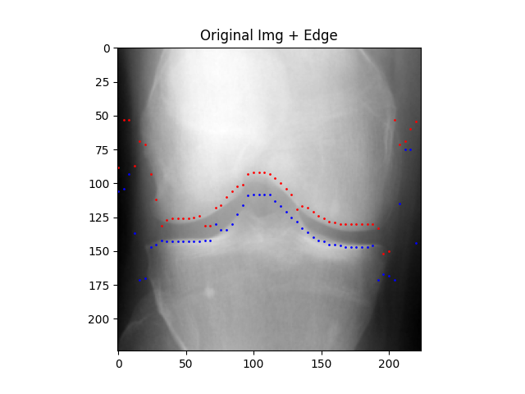

Results : Edge Detection
superimpose
56 points along upper edge
Width = 224
Interval = 4
40 : 70
Joint space width
Region of interest
155 : 185
56 points along lower edge

Slide 30

Results : Edge Detection (Contd.)
U
P
P
E
R
E
D
G
E

Slide 31

Results : Edge Detection (Contd.)
L
0
W
E
R
E
D
G
E

Slide 32

Results : Joint Space Width per Image
CORRESPONDING POINT DISTANCES
LEFT ROI [10:17]
RIGHT ROI [39:46]

Slide 33



Results : Joint Space Width per Image (Contd.)
ROI GAPS : 0
ROI GAPS : 2
ROI GAPS : 4

Slide 34



Results : Distribution Plots per Grade
Grade 0
Denoising

Slide 35



Results : Distribution Plots per Grade (Contd.)
Grade 1
Denoising

Slide 36



Results : Distribution Plots per Grade (Contd.)
Grade 2
Denoising

Slide 37



Results : Distribution Plots per Grade (Contd.)
Grade 3
Denoising

Slide 38



Results : Distribution Plots per Grade (Contd.)
Grade 4
Denoising

Slide 39
Results : Joint Space Width per Grade
Grade | Left Joint Space |  |  | Right Joint Space
 | Mode | Mean | Std. Dev. | Mode | Mean | Std. Dev
0 | 18 | 18.91 | 2.58 | 18 | 18.88 | 2.42
1 | 18 | 15.94 | 2.87 | 18 | 16.32 | 2.84
2 | 15 | 14.30 | 4.07 | 15 | 14.45 | 3.76
3 | 12 | 11.80 | 4.01 | 12 | 12.68 | 2.41
4 | 12 | 11.38 | 4.71 | 12 | 11.73 | 4.82

Slide 40
Results : Joint Space Width per Grade (Contd.)
Grade | Left Joint Space |  | Right Joint Space
 | px | % | px | %
0 | 19 | 8.00 | 19 | 8.00
1 | 16 | 7.00 | 16 | 7.00
2 | 14 | 6.00 | 14 | 6.00
3 | 11 | 5.00 | 12 | 5.00
4 | 11 | 5.00 | 11 | 5.00
Pixel values taken from
Mean and Mode
16
224
100 = 7.14
≈ 7.00
Image height

Slide 41
Optimum Range for Osteoarthritis
Images from grade 3 and 4 are definitely having Osteoarthritis.
Those from 2 having narrowed joint space are Osteoarthritic.
It is observed that, Joint Space Width for all of these are below 7%.
Therefore, if a knee joint under diagnosis, have joint space width less than 7%, we can say that, it is affected by Osteoarthritis.
Joint Space Width < 7% => Osteoarthritis ⚠️

Slide 42
Performance

Slide 43
Test for Validity of Osteoarthritis Detection
Test Dataset
Image
Image
Segmentation
Grade | Images
0 | 92
1 | 95
2 | 97
3 | 93
4 | 24
Joint Space(%)
Calculation
Edge Detection
no
< 7%
yes
n
0/1/2
4/3/2
y
y
n
F
T
F
T

Slide 44


Detection Validity Test : Outputs

Slide 45


Performance Metrics
Overall Accuracy = 82.96%

Slide 46




Performance Metrics (Contd.)
Average Precision :
Sensitivity / Recall :
Specificity :
F1 Score :
0.54
0.73
0.74
0.62
Overall Accuracy = 82.96%
Notes:
In quantitative analysis, we used three performance metrics for our CNN-base 3D U-net framework. These are: mean Intersention over union, Dice similarity coefficient and average precision. for our experiment, we achieve mean IoU of 0.973, Dice coefficient of 0.988 and average precision of 0.953. All these performance metric shows the efficiency of our proposed framework.

Slide 47
Our Contribution

Slide 48
Our Contribution : Efficient Low Resource System
Needs a lot of labeled data
Osteoarthritis Detection
KL Grade
Classification
CNN
Sobel Edge Detection
Low resolution noisy data
FastSAM
Segmentation
Edge Detection
Reasonable
Results
Low resource
Computationally efficient

Slide 49

Our Contribution : Pre-Diagnosis
Need further diagnosis
It may save valuable time and money by utilising very low resources and computation in a very short time
No
Osteoarthritis
This may cause
Significant waste of time and money
Advanced diagnostics
Test with our system
NO
May have mild Osteoarthritis. Go for Advanced Diagnostics to confirm.
YES
Sure to have Osteoarthritis. Go for treatment.

Slide 50
Conclusion
Accurate joint space measurement aids in advanced diagnosis and treatment decisions.
Achieved 82.96% accuracy in osteoarthritis detection.
Suitable for low-resource settings and easy to use clinically.
Demonstrated efficiency and clinical utility of the proposed framework.

Slide 51
Future Directions
Incorporate osteophyte detection for improved accuracy.
Detecting presence and level of Subchondral sclerosis.
Conduct extensive clinical validation.
Optimize edge detection and statistical analysis algorithms.
Explore broader applications in joint assessments.
Develop software tools for integration into diagnostic workflows.

Slide 52
References
Sudeep Kondal and Viraj Kulkarni and Ashrika Gaikwad and Amit Kharat and Aniruddha Pant, “Automatic grading of knee osteoarthritis on the Kellgren-Lawrence scale from radiographs using convolutional neural networks,” eess.IV, 2020, pp. 1–6
Antony, Joseph and McGuinness, Kevin and Moran, Kieran and O’Connor, Noel E., “Quantifying radiographic knee osteoarthritis severity using deep convolutional neural networks,” Springer International Publishing, 2017, pp. 376–390.
Tiulpin A, Thevenot J, Rahtu E, Lehenkari P, Saarakkala S.,“ Automatic Knee Osteoarthritis Diagnosis from Plain Radiographs: A Deep Learning-Based Approach.,” Sci Rep., 2018 Jan 29, pp. 8(1):1727
Brahim A, Jennane R, Riad R, Janvier T, Khedher L, Toumi H, Lespessailles E.,“A decision support tool for early detection of knee OsteoArthritis using X-ray imaging and machine learning: Data from the OsteoArthritis Initiative,” Data from the OsteoArthritis Initiative.
Behzad Heidar, “Knee osteoarthritis prevalence, risk factors, pathogenesis and features: Part I,”Caspian J Intern Med. 2011 Spring, pp. 2(2):
Kohn MD, Sassoon AA, Fernando ND, “Classifications in Brief: Kellgren-Lawrence Classification of Osteoarthritis, ” Clin Orthop Relat Res. 2016 Aug, pp. 474(8):1886-93.
Xu Zhao and Wenchao Ding and Yongqi An and Yinglong Du and Tao Yu and Min Li and Ming Tang and Jinqiao Wang“Fast Segment Anything,”, 2023

Slide 53
Thank you!

